Slide 1
UNIT-I Principal of Security, Security Services CAP404 INFORMATION SECURITY AND PRIVACY
SCHOOL OF COMPUTER APPLICATIONS
DOMAIN: AI &ML

Slide 2
Cryptography and Network Security Principles
Cryptography and network security are essential for protecting information systems from unauthorized access, ensuring secure communication, and maintaining trust in today’s digital world.
Protects sensitive data from cyber attackers
Ensures secure communication over networks
Maintains confidentiality, integrity, and availability
Forms the foundation of modern cybersecurity systems

Slide 3

Cryptography

Slide 4
Types of Cryptographic Attacks
Passive Attacks
Attackers silently monitor or intercept data
No modification of data occurs
Examples: Eavesdropping, traffic analysis
Active Attacks
Attackers modify, delete, or disrupt data
Can cause serious damage to systems
Examples: Data modification, denial-of-service attacks

Slide 5
Fundamental Network Security Principles
1. Confidentiality
Ensures that information is accessible only to authorized users.
Prevents unauthorized disclosure of data
Encryption plays a major role
Compromised if intercepted by attackers

Slide 6
2. Authentication
Verifies the identity of users or systems.
Ensures only legitimate users gain access
Common methods include usernames, passwords, and biometrics
3. Integrity
Guarantees that data remains accurate and unchanged.
Detects unauthorized modifications
Applies to both stored and transmitted data

Slide 7
4. Non-Repudiation
Prevents users from denying their actions.
Ensures proof of message origin
Commonly achieved using digital signatures
5. Access Control
Controls who can access data and to what extent.
Based on roles and permissions
Prevents misuse of sensitive information

Slide 8
6. Availability
Ensures systems and data are accessible when needed.
Protects against service disruptions
Requires backups and redundancy

Slide 9
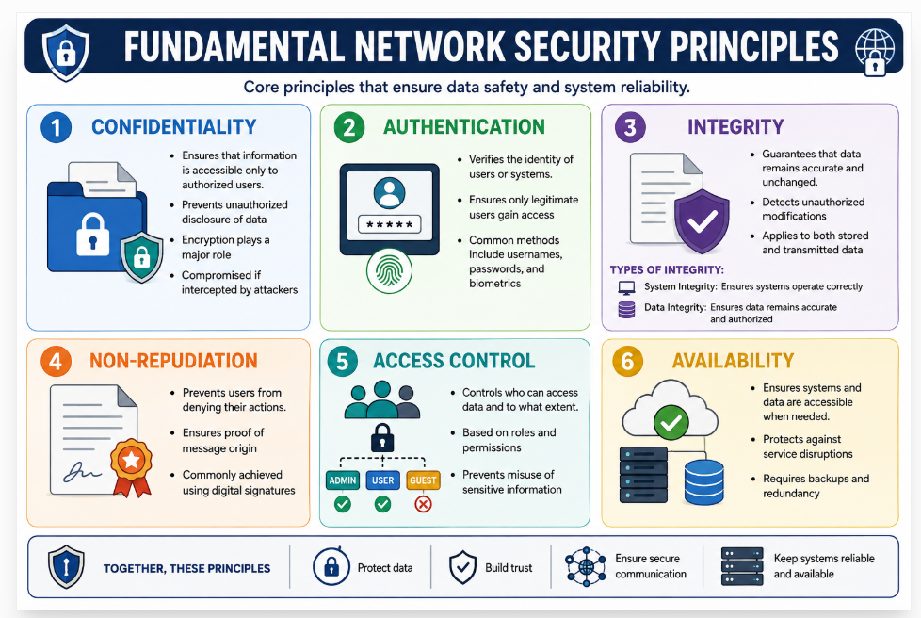

Slide 10
Security Services
Security services in cryptography are system features that protect data, maintain privacy, and build trust using mathematical algorithms. The key services are confidentiality, integrity, and authentication
Core Security Services
Confidentiality (Secrecy): Keeps data private by turning it into unreadable code using encryption so only authorized people can read it.
Integrity (Data Accuracy): Ensures data has not been changed, tampered with, or destroyed by unauthorized users during transfer or storage.
Authentication (Identity Verification): Confirms that users, devices, or data sources are who they claim to be.
Non-Repudiation (Proof of Action): Stops a person from falsely denying they sent or received a message or transaction.
Access Control (Authorization): Limits who can view or use specific system resources and data based on verified permissions.

